Slide 1
Gaussian mixture model

Slide 2
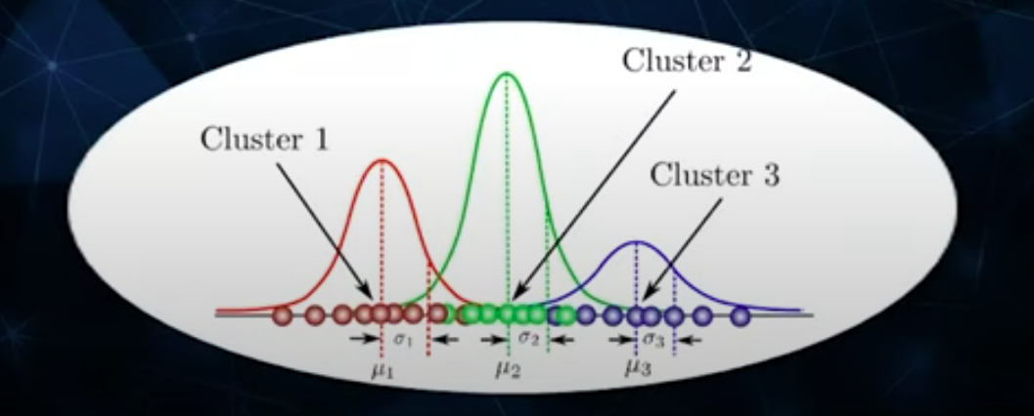
What is Gaussian Mixture Model?
A Gaussian Mixture Model (GMM) is a probabilistic model representing data as a mixture of multiple Gaussian distributions
Each Gaussian distribution represents a component or cluster within the Data.

Slide 3
It is mixture model because it assumes that data points are generated from a mix of Gaussian distribution.
The model assumes that the data points within each cluster are generated from a guassian distribution with its mean, covariance and combines with weight to form overall probability distribution of the data.
it is quite natural and intuitive to assume that the clusters come from different Gaussian Distributions

Slide 4
Both are clustering algorithms, but one important distinction is that K-Means assigns each data point to the cluster of its nearest neighbours, whereas
GMMs introduce a probabilistic approach by modeling data points as a mixture of multiple Gaussian distributions.
GMMs assigns a softer clustering label, telling us how probable it’s for a data point to belong to a certain cluster.
Simply, fitting a gaussian distribution would not yield good results since this data is grouped into several clusters.
So, in order to have a much more representative distribution for it, you need to fit a Gaussian on top of each cluster, which is basically what the GMM tries to achieve.

Slide 5
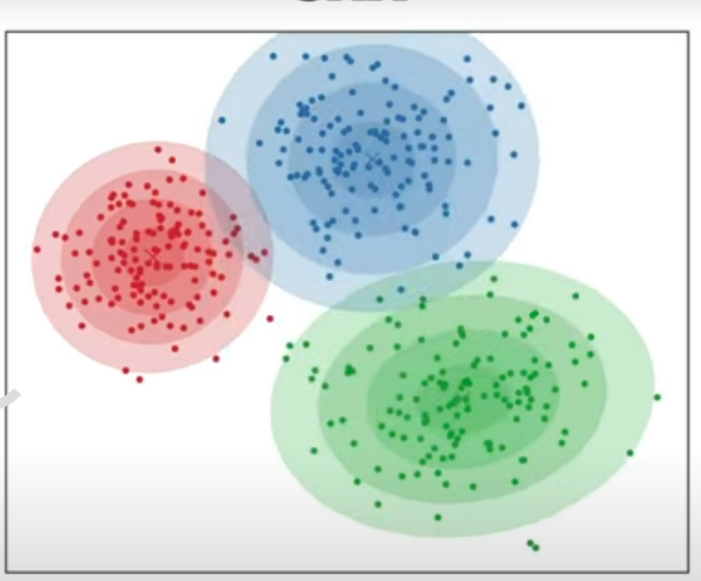
GMM
60% red
30 % blue
10% green

Slide 6
In short, the Expectation-Maximization (EM) algorithm is a quite powerful iterative optimization method that’s used to esimate parameters in statistical models when there is missing or incomplete
it consists of iteratively applying two steps:
The expectation step: where the algorithm calculates the expected value of the log-likelihood function given the current parameter estimates.
The maximization step : where the algorithm updates the parameter estimates to maximize the expected log-likelihood calculated in the E-step.

Slide 7
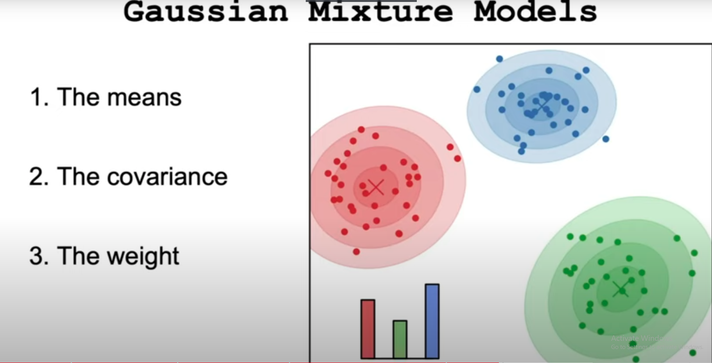

Slide 8
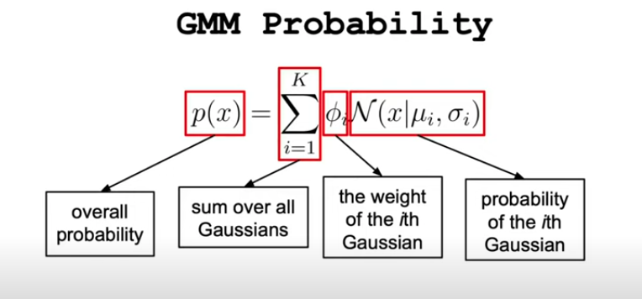

Slide 9
The Expectation-Maximization (EM) algorithm is a powerful iterative method used for finding maximum likelihood estimates of parameters in statistical models, particularly when the data is incomplete or has missing values.
It is widely used in various applications, including clustering, classification, and estimation of hidden variables.
The EM algorithm alternates between two main steps: the Expectation (E) step and the Maximization (M) step.

Slide 10
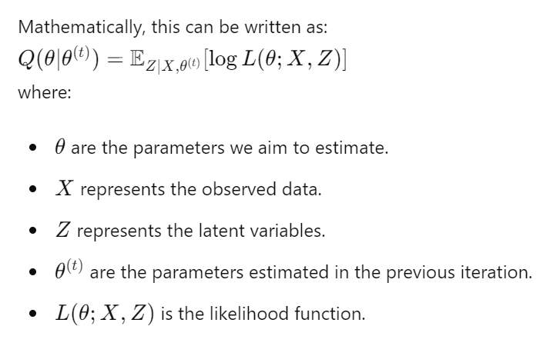

Slide 11

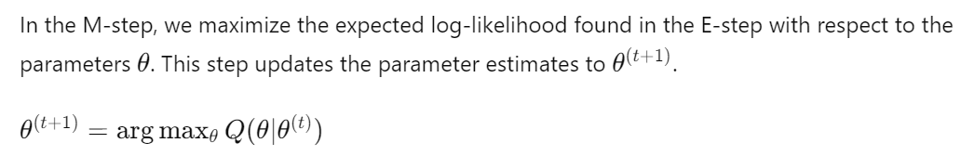

Slide 12
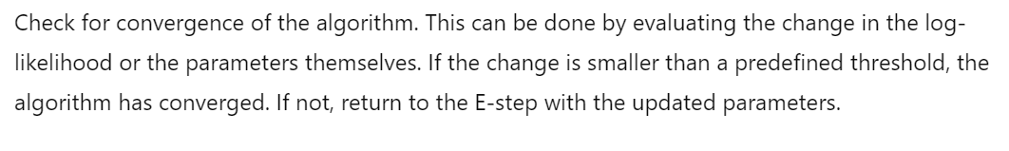
Convergence Check

Slide 13
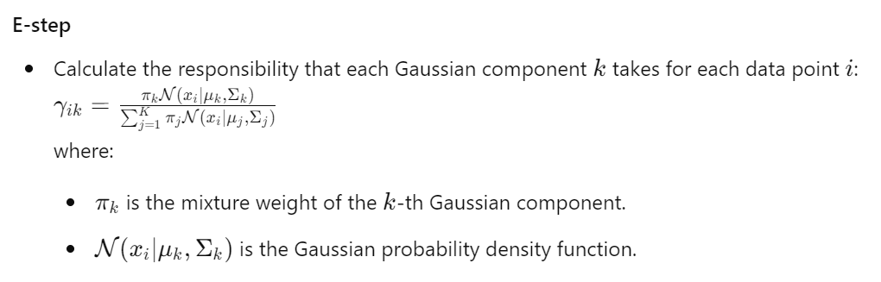
Gaussian Mixture Models (GMM)
X are assumed to come from a mixture of several Gaussian distributions, and the latent variable
Z indicates which Gaussian distribution each data point is drawn from.

Slide 14
